Slide 1
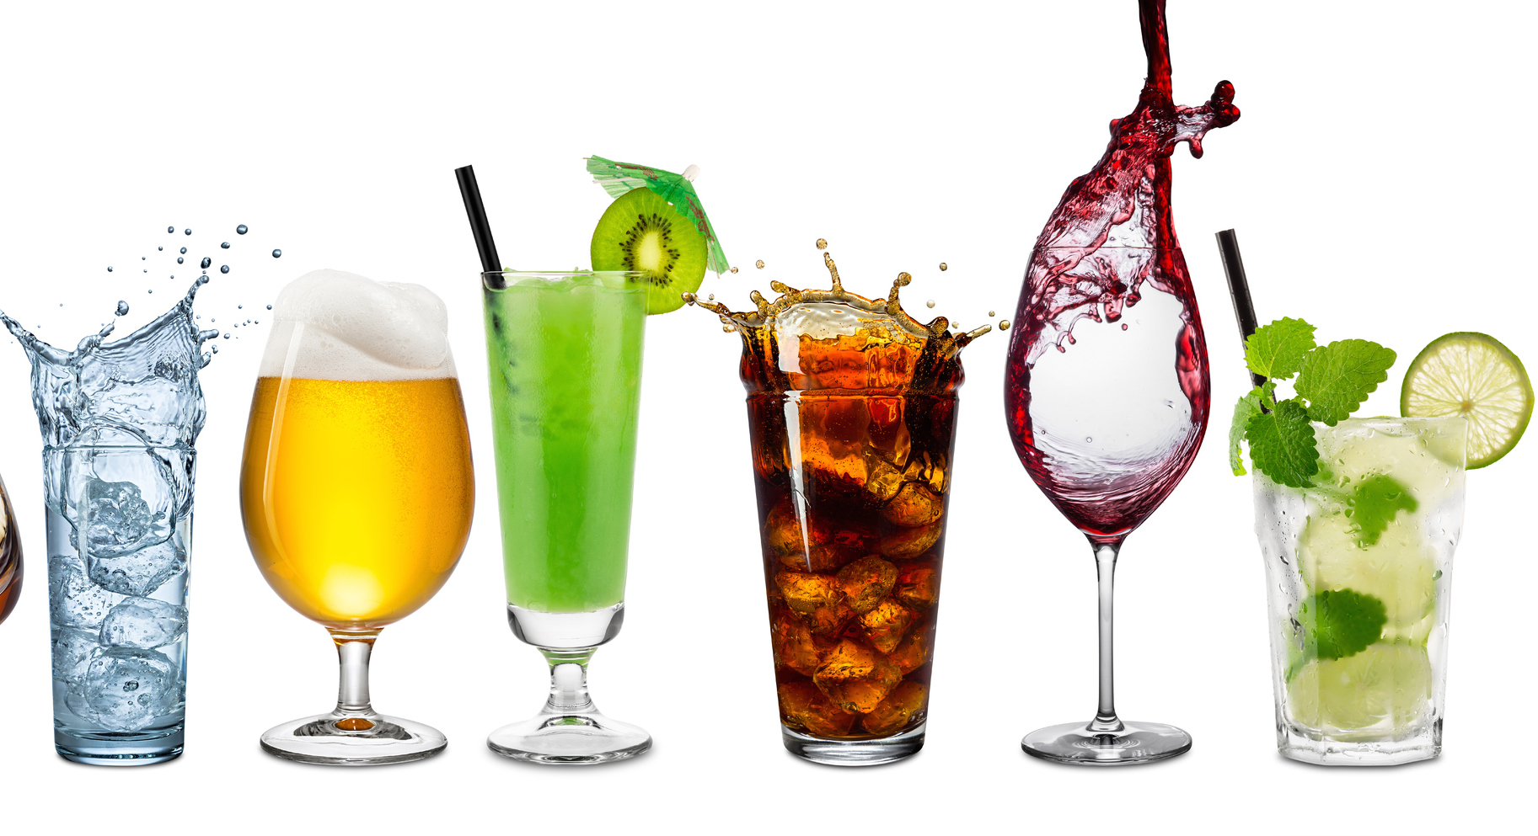
DEVELOPMENT OF CARBONATED BEVERAGE PLANT
PROJECT ON ENTREPRENEURSHIP
Guide – APURBA GIRI¹ &
AYAN MONDAL²
HEAD OF ASSISTANT PROFESSOR¹
ASSISTANT PROFESSOR²
(DEPT. OF NUTRITION)
Mugberia Gangadhar Mahavidyalaya
PROJECTED BY –PUTUL GOCHHAIT
Roll – 2220
Department of Nutrition,
B.Voc Food Processing 6th semester
Mugberia Gangadhar Mahavidyalaya

Slide 3
Why I Started this business
High market demand and growing industry .
High profitable business .
It can be start in a small plan .
Manufacturing procedure is very simple .
Marketing is very simple because of high demand in populated areas

Slide 4
Location & area
Raw material availability .
Location ( with respect to the marketing area)
Availability of suitable land .
Transport facilities .
Availability of labours .
Availability of utilities ( Water , Electricity ) .
Environmental impact and effluent disposal .
Local community considerations .
Climate .
1200-1400sq.ft.

Slide 5
Investment
Approx 50lakhs – 60 lakhs
Financial Resources
Sources of finance
Spontaneous
Short term
Long term
Retained profit
Trade credit
Bank loan
Government loan
Short term loan
Public Deposit

Slide 6
Certificates & License
Food Safety & Standards Authority of India (FSSAI) food licence
Indian Standards Institution mark (ISI mark)
ESI or Employee State Insurance
GST
Trademark Registration
No objection certificate

Slide 7
Types of product
Soda water
Lemon flavoured carbonated beverage
Ginger flavoured carbonated beverage
Lemon & watermelon flavoured carbonated beverage
Watermelon flavoured carbonated beverage

Slide 8
Raw material
Water
Lemon
Watermelon
Co₂
Sugar
Bottle
Ginger
Other packaging material

Slide 9
EQUIPMENT DETAILS
Serial No. | Equipments | Number | Cost
Production equipment's
01. | Tanks | 8 | 56000
02. | Boiler | 1 | 50000
03. | Automatic bottle washing machine | 1 | 60000
04. | Pasteurizer | 1 | 50000
05. | Co₂ cylinder | 1 | 3000
Quality control & testing equipment's
06. | Gas volume analyzer | 1 | 19000
07. | Refractometer | 1 | 35000
08. | Density Meter | 1 | 69000
Packaging equipment's
09. | Automatic Bottle filling machine | 1 | 200000
Distribution equipment's
10. | Truck | 1 | 600000

Slide 11
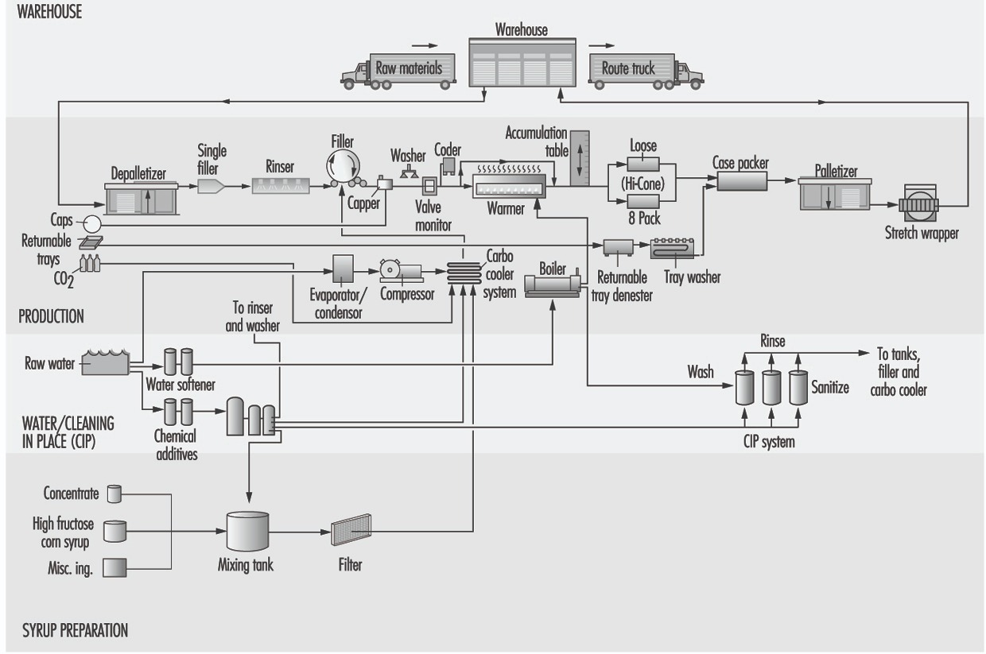
Production Process
Flavour
Colour

Slide 12
Laboratory Test
Titration
Gas volume analyzer
Refractometer
Density Meter
Brix Meter
Viscometers
Sensory Test
Microbiological Test
Water quality Test

Slide 13
Product Details
Objective | 200ml | 500 ml | 1 litre
Bottle | 1.55 | 2.10 | 2.85
Cap | 0.50 | 0.28 | 0.28
Flavour | 3.37 | 9.5 | 19
Gas | 0.018 | 0.045 | 0.09
Water | 0.25 | 0.625 | 1.25
Electricity | 0.60 | 0.60 | 0.60
Labour | 0.13 | 0.13 | 0.13
Sticker | 0.30 | 0.45 | 0.60
Packaging | 0.19 | 3 | 5
Others | 2 | 2 | 2
Size of bottle | Total cost | Wholesaler cost | MRP | Profit
200ml | 8.908 | 14 | 17 | 5.092
500ml | 18.73 | 26 | 30 | 7.27
1liter | 31.26 | 49 | 55 | 17.74

Slide 14
Start up cost
Land – 2500000
Building – 1000000
Machinery – 1115000
Raw material – 100000
Salary –300000
Others - 700000
Distribution Process
Raw material
Plant
Distributor
Retailer
customer

Slide 15
Organization Plan
INTRAPRENEUR
Accountant
Production manager
Purchasing manager
Collection Manager
Marketing manager
Worker
Worker
Worker
Worker
Transportation supervisor
Packaging supervisor
Worker
Worker
Worker
Worker

Slide 16
Advertisement & Promotion

Slide 17
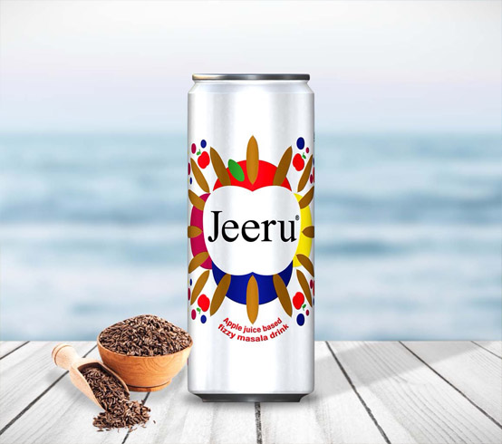
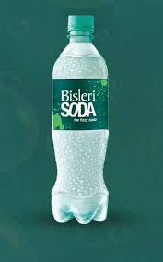
Target audience
ANALYSIS OF COMPETITOR
Core Customers :-
Sweets shop
Hotels& Restaurants
Marriage and function
Online
Others customer
Middle and upper class households
Festivals and rituals

Slide 18
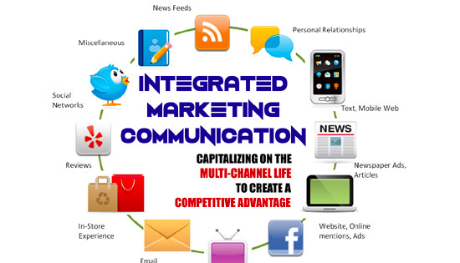
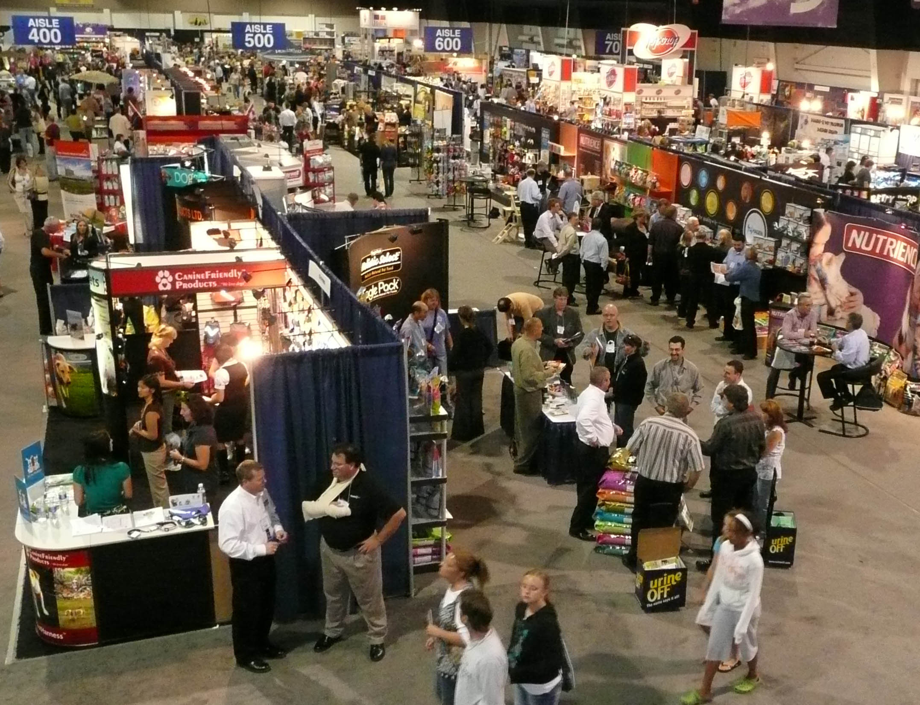
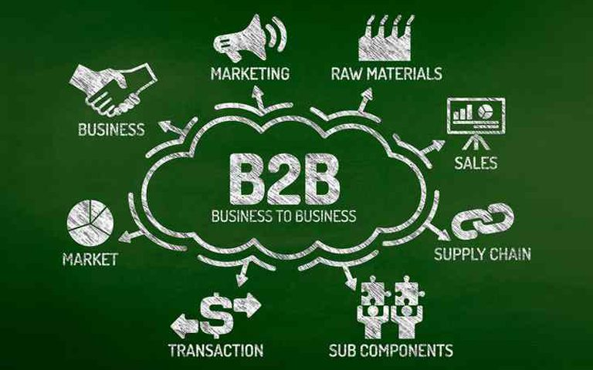
Strategies We Follow
IMC
Trade Show Marketing
Digital Marketing
B2B Marketing

Slide 19
Key to success
Strengths
Unavailability of beverage industry in this location
Easily available of raw material
Opportunities
Export product to others countries
Higher demand of product
SWOT Analysis
Threats
Competitor can produce the same product
New innovation from others competitors
Weaknesses
High market competitor

